Slide 1
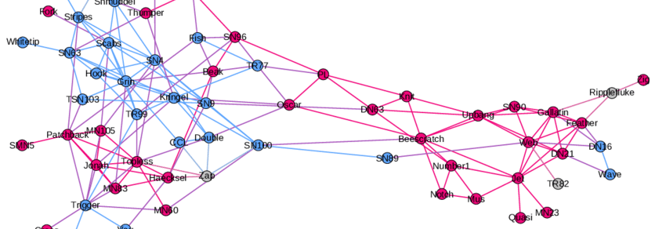
Graph Neural Networks
Notes:
Main source: https://distill.pub/2021/gnn-intro/

Slide 2
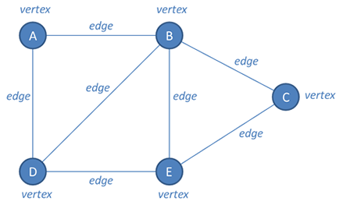
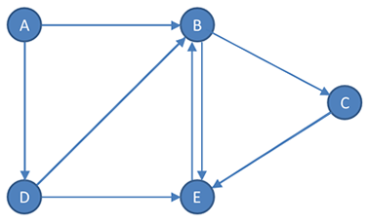
What is a Graph?
Graph components
Directional Graph example

Slide 3
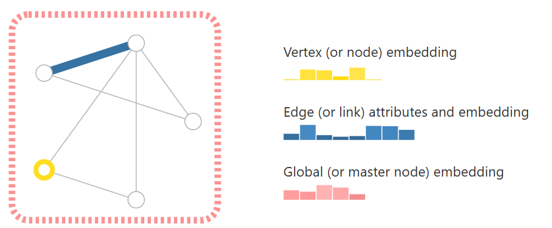
Graph representation

Slide 4
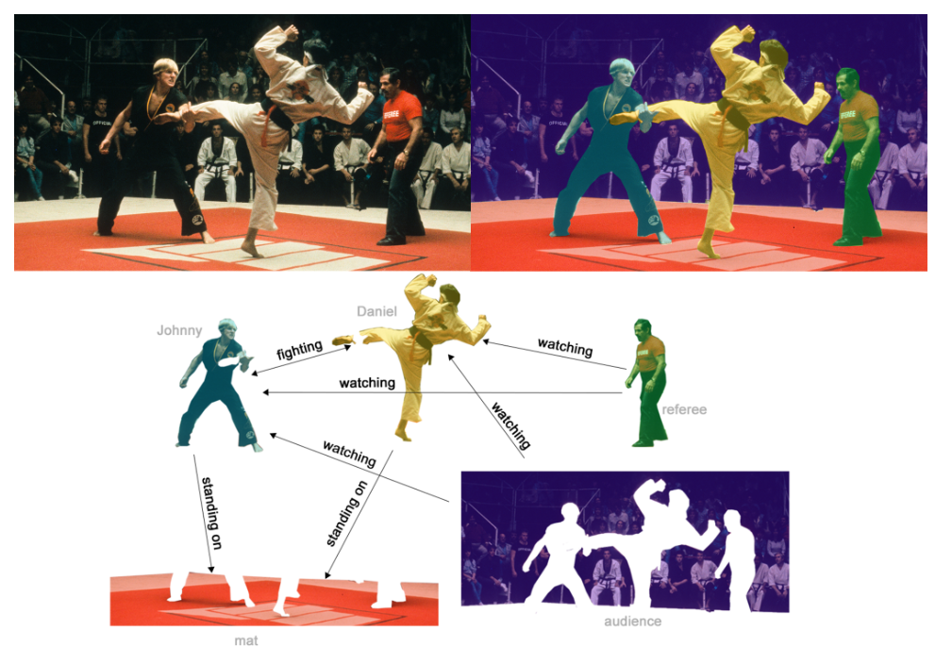
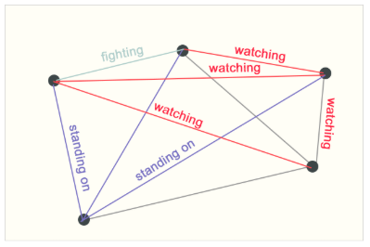
Graph representation

Slide 5
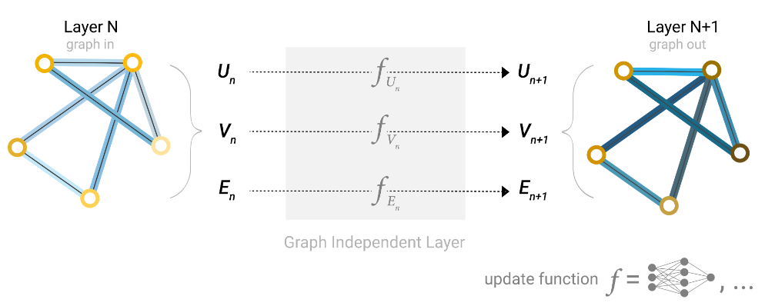
Processing methods: GNN
Notes:
U – Graph level
V – Node level
E – Edge level

Slide 6
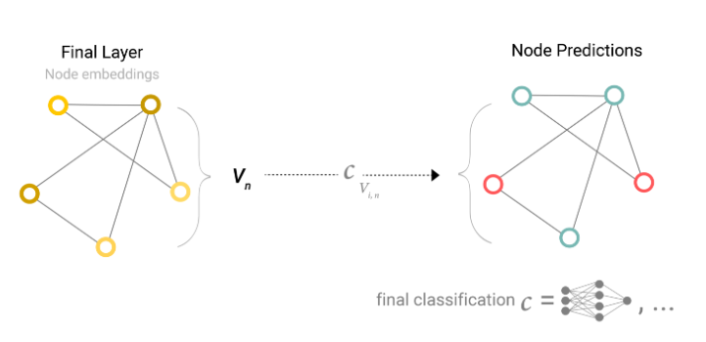
Processing methods: GNN

Slide 7
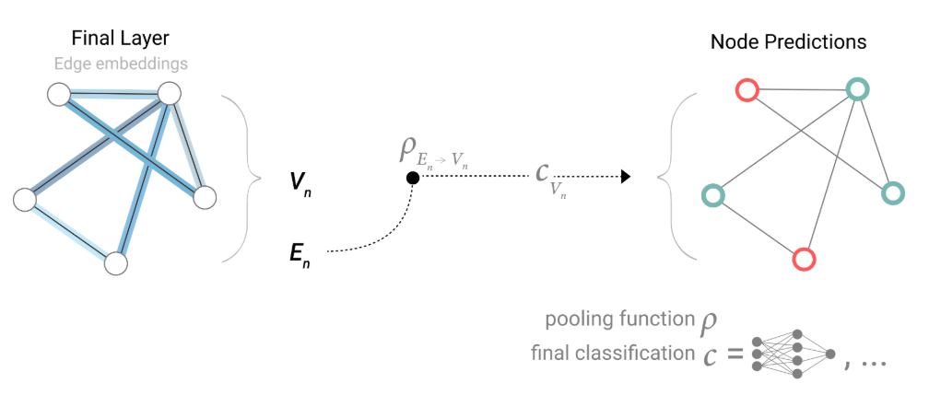
Processing methods: GNN

Slide 8
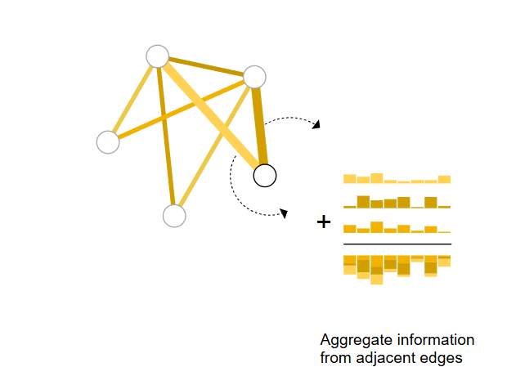




Processing methods: GNN
Aggregation methods

Slide 9
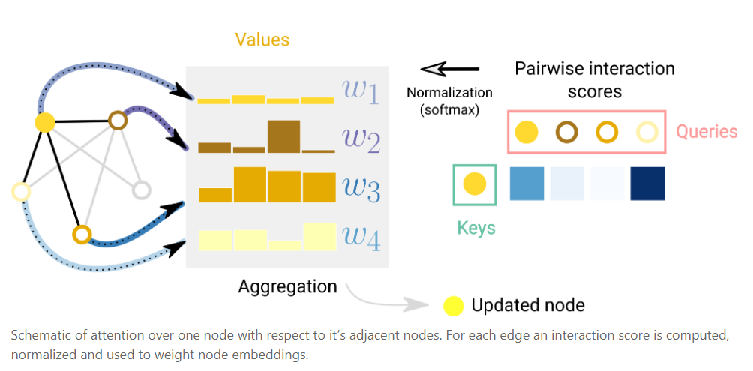
Processing methods: GNN

Slide 10
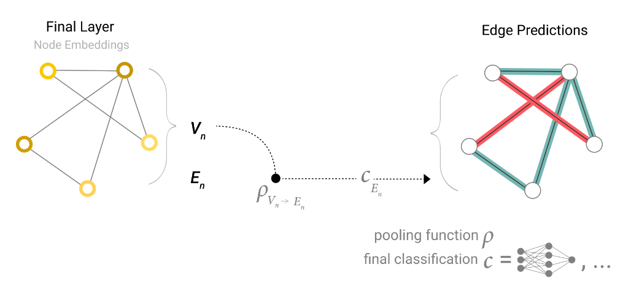
Processing methods: GNN

Slide 11
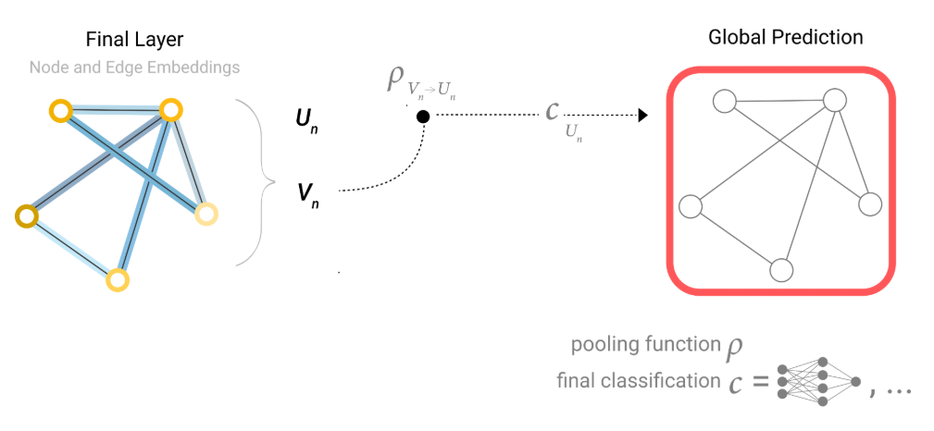
Processing methods: GNN

Slide 12
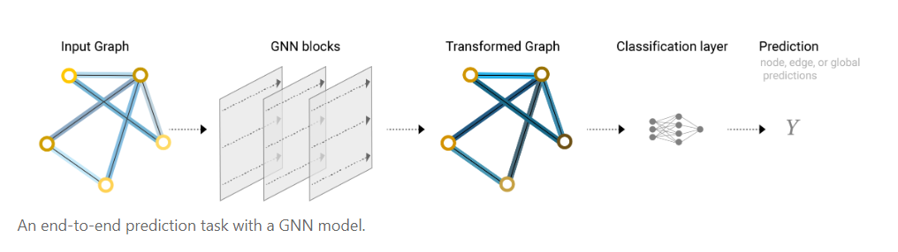
Processing methods: GNN

Slide 13
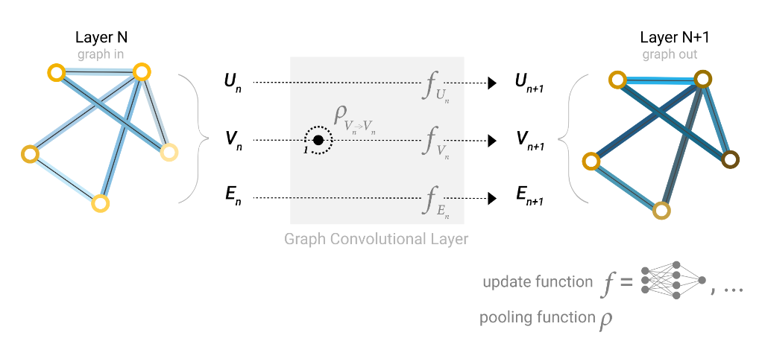
Processing methods: GNN

Slide 14
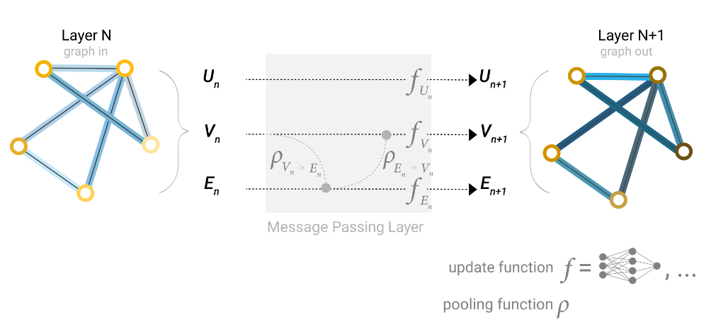
Processing methods: GNN

Slide 15
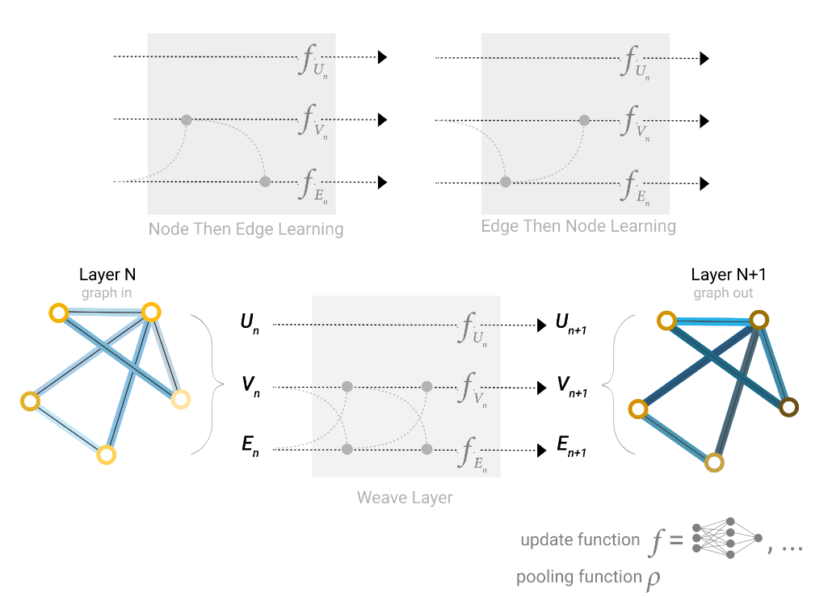
Processing methods: GNN

Slide 16

Processing methods: GNN

Slide 17
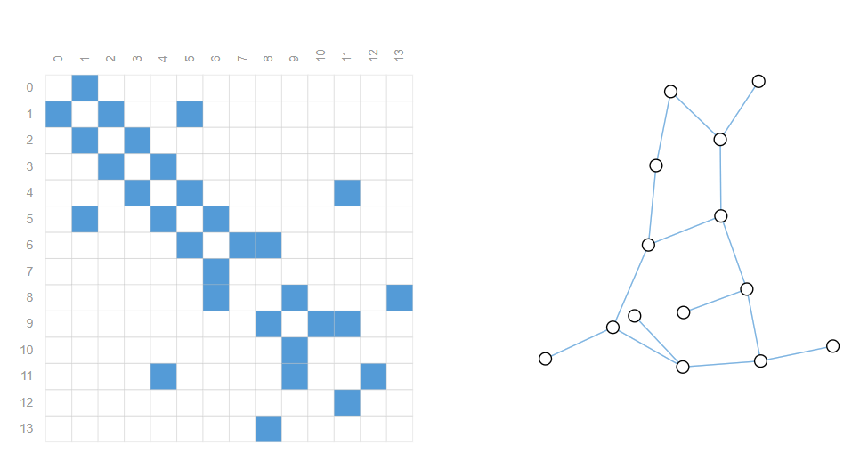
Talking about adjacency

Slide 18
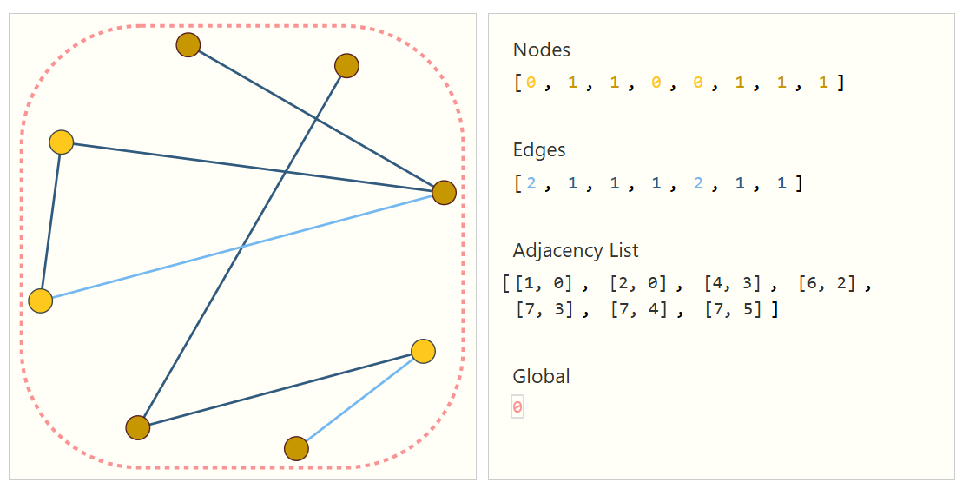
Talking about adjacency

Slide 19
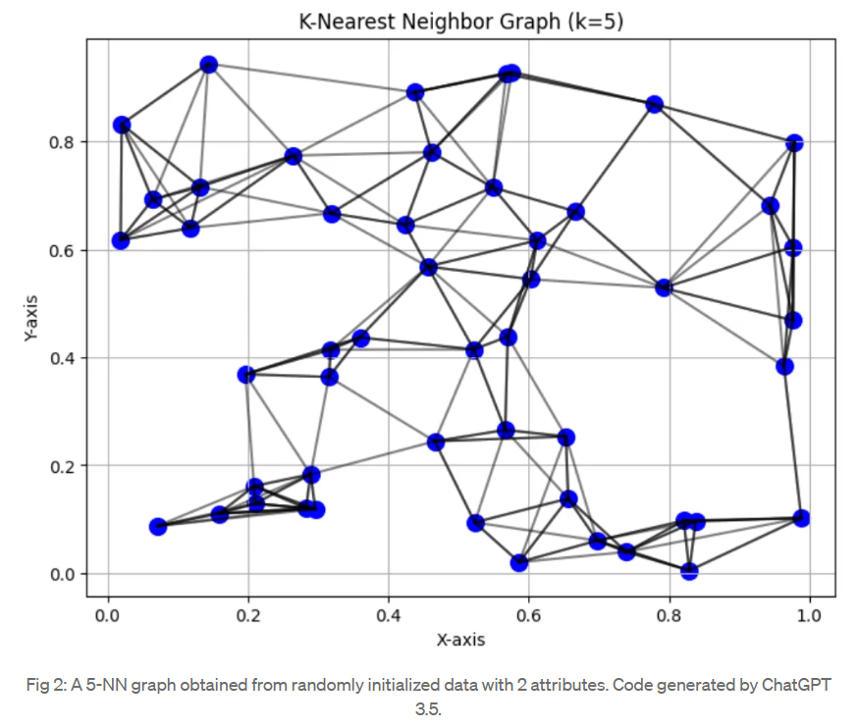
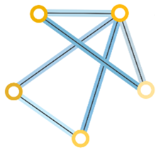
Adaptive GNN – adjacency layers

